Slide 1
Storytelling
with GIS Maps
Digital Scholarship Workshop Series
NCSU Libraries
Erica Hayes and Mia Partlow
Notes:
Mia start

Slide 2
Agenda
Why use maps for storytelling?
What are Esri Story Maps?
Tips for telling a good story
Types of Story Map Applications
Examples of Story Maps
Mapping Activity
Experiment & Practice
Technical Advice & Helpful Resources
Contact info
Notes:
Mia start
To begin, I thought I’d provide a brief agenda of what we will be covering in the workshop today. I’ll go over a few reasons why maps are good for storytelling, tips for telling a good story, what esri story maps are, and examples of story maps. I’ll then provide you with sample images, text, and locations for our Mapping Activity. I think we’ll have time to build two different story maps to give you a sense of the different layout options.

Slide 3
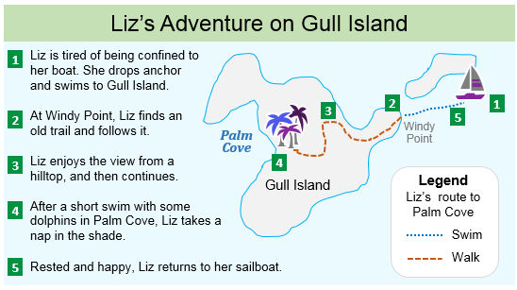
Why use maps for storytelling?
Maps can help you...
Visualize
Where events happened
Distance
Gaps & clusters
Networks & movement
Gain insight into how far a character, person, disease, or animal, etc. traveled
Gain insight into why certain events happened
Notes:
So, why are maps useful for storytelling. Some of the obvious reasons are they help us visualize where events happened, giving you new insight into the events.
Mapping enables you to visualize: distance, gaps and clusters -- so we’re talking about distribution and proximity. Look at the map of Liz’s adventure on Gull island. There’s a gap here. Why didn’t Liz visit the southernmost tip? Perhaps it is difficult terrain. So in this case, your map could be a way to explore the data in order to facilitate further analysis. Or, as this map is doing, to tell a story of Liz’s walk from point to point.
Or you could visualize the movements of two or more people, animals, or diseases--did they intersect? What is the relationship? Thinking spatially can unveil new information, and allow you to present your information visually, so it is clear and intuitive to your readers.
Spatially, you can also analyze the distance and paths a character, person, or disease traveled, as well as investigate why certain events happened.

Slide 4
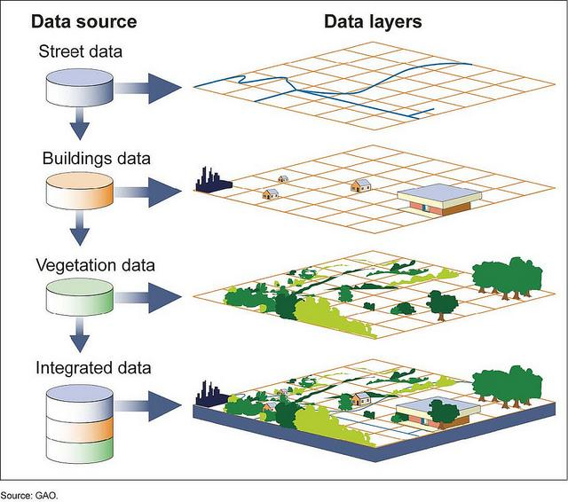
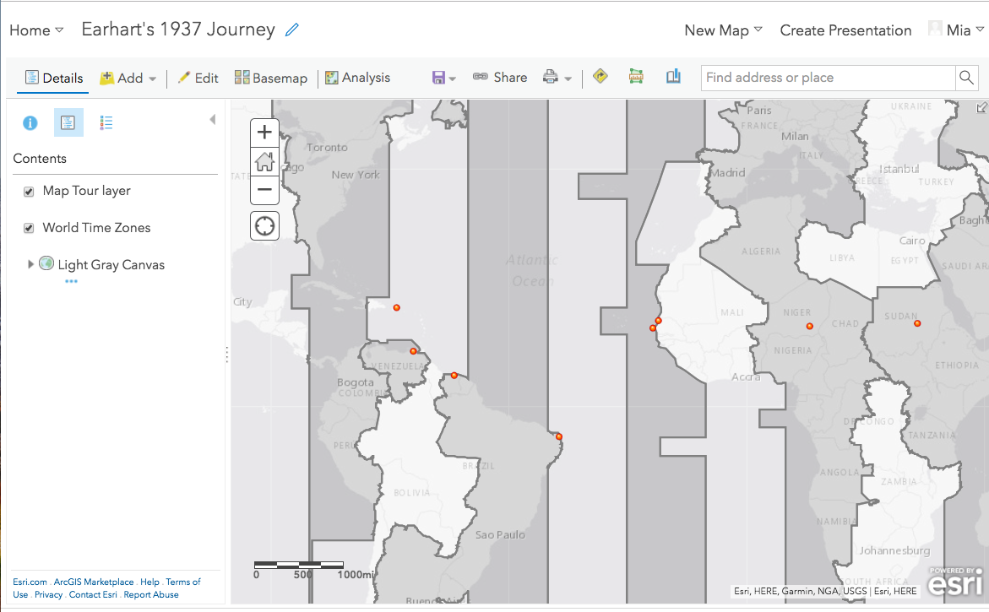
GIS Basics
Geographic Information System (GIS):
A system designed to capture, store, manipulate, analyze, manage, and present all types of geographic data
GIS organizes layers of information into map visualizations
GIS can analyze spatial data and reveal patterns and relationships.
Examples:
ArcGISOnline
ArcMap
QGIS
Definition from a 1999 GIS Lounge post by Caitlin Dempsey
Notes:
As we’ll see, Story Maps are a very user-friendly way to use maps to power your storytelling. But they are also a good introduction to using GIS, so we wanted to give a very brief introduction and definition. Read from slide for GIS -- and when I say ‘geographic data,’ I mean information that is attached to a place on the earth. These places will be represented by latitude and longitude. So we can see on this map point data -- in red -- as well as a layer of time zones, which are shapefiles -- essentially, many latitude and longtiude points connected into geometric shapes. You can analyze gis data by use the shapes, points, and their attributes--so, the number of people who live inside of this time zone. Or distance from one to another. There’s a lot you can do with maps -- as I said, visualizing distance, distribution, gaps and movement. All of these visualizations have a story to tell, and that’s where Story Maps come in.

Slide 5
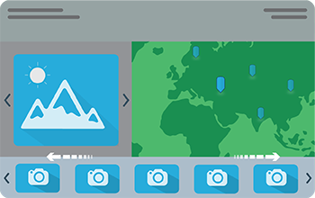

What are Esri Story Maps?
Esri Story Maps are simple web-based applications that combine interactive ArcGIS Online basemaps, multimedia content, and text to create your own geographic narrative. Hosted in the cloud, Story Maps enables you to build your own story with no web development or GIS programming skills.
Notes:
So, what are Esri Story Maps? Esri Story Maps are simple, web-based applications that combine interactive free ArcGIS Online basemaps, images, video, and text to create your own geographic story. Esri Story Maps are hosted in the cloud and unlike the proprietary ArcGIS software, anyone can use Esri Story Maps and share them freely online.
They are also very easy to use. You can create beautiful maps and you don’t have to have web development or GIS programming skills. When people first get started with GIS, it’s very exciting to create a beautiful map, but then what? Embedding your map into a website and building all of the interactivity--different images and text alongside your map or multiple maps, for example--is technically very difficult. Story Maps templates make it really easy to choose the type of interaction you want so you can focus on your story.

Slide 6
Tips for telling a good story
Connect with your audience
who are they?
what do you want them to learn?
Choose the best application that matches the media, amount of text, and story you want to tell.
Do you want readers to follow a story sequentially, or do you want them to jump back and forth, such as a before-and-after view?
Avoid visually complex symbols and icons
Strive for simplicity & brevity when possible.
Notes:
Mia last slide
So, before you begin creating your map, you’ll want to think about how you want your map to connect with your audience: who are they? Are they a class, the public at large, your peers, or family? What do you want them to learn? You’ll also want to consider which story map application is best suited to your needs. There are quite a few of them you can choose from and all of them have different strengths depending on the media you want to share whether that is a video or image and how much text you are planning on including in your story map. Other templates are laid out to encourage readers to read sequentially, from beginning to end, so you can control how the narrative unfolds. Or you can let readers jump back and forth between maps to compare multiple views and sides of a story.
Some maps are much more suited to more narrative than others, but generally for readability you’ll want to strive for brevity and simplicity, while avoiding visually complex symbols and icons.

Slide 7
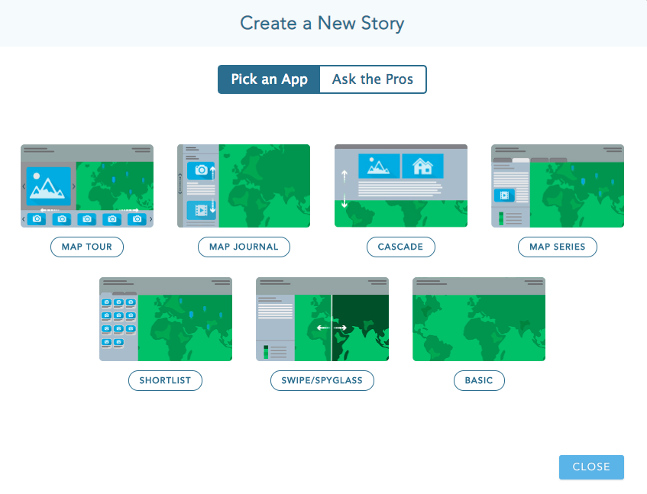
Types of Story Map Applications
Notes:
Erica start.
There are many different types of story map applications. I’ll provide more examples of some of these listed here but this is a quick snapshot of what story map templates you will be able to pick from when you first start to create a story map.
What do I mean by application? Story Maps apps are templates for different layouts you want, but also templates for the type of interaction you want your readers to have with your information. For example: do you want them to get an overview of the whole story at once, or do you want them to navigate through it? Or compare a before and after? All of these are possible.

Slide 8
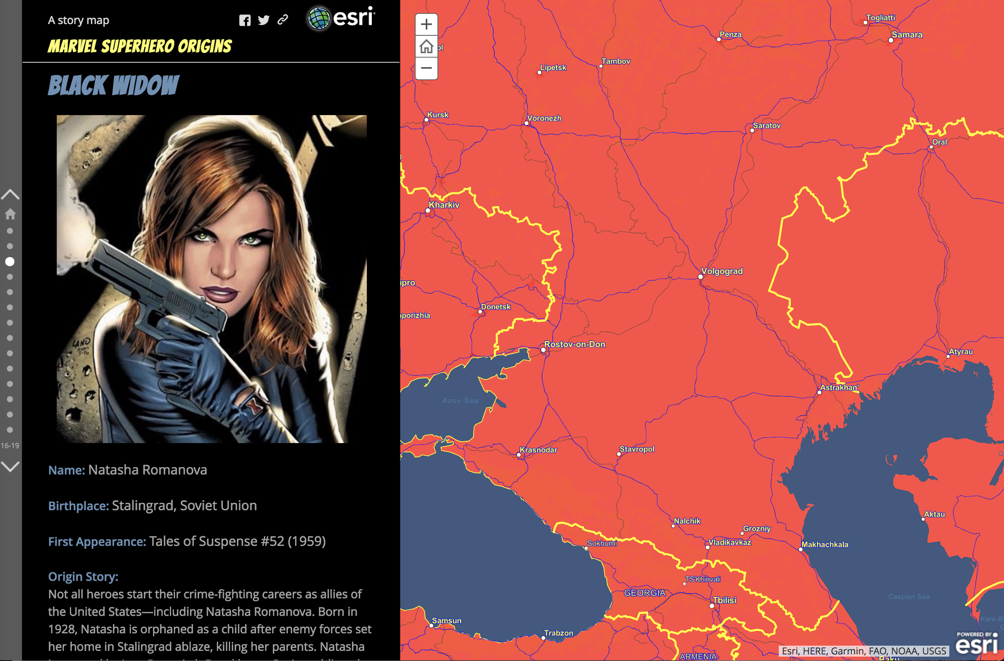
Example--Story Map Journal
Story Map Journal: ideal when you want to scroll through sections of maps and combine it with narrative text, images, or videos. Each section in a Map Journal has an associated map, image, or video and text.
Notes:
To provide you with some examples, the Story Map Journal is ideal when you want to scroll through sections of maps and combine it with narrative text, images, or videos. Each section in a Map Journal has an associated map, image, or video and text. It is also useful if you have a lot more to say and plan on writing a lot about a particular topic. The long format of the Map Journal provides you more opportunities to create a map, image, or video.

Slide 9

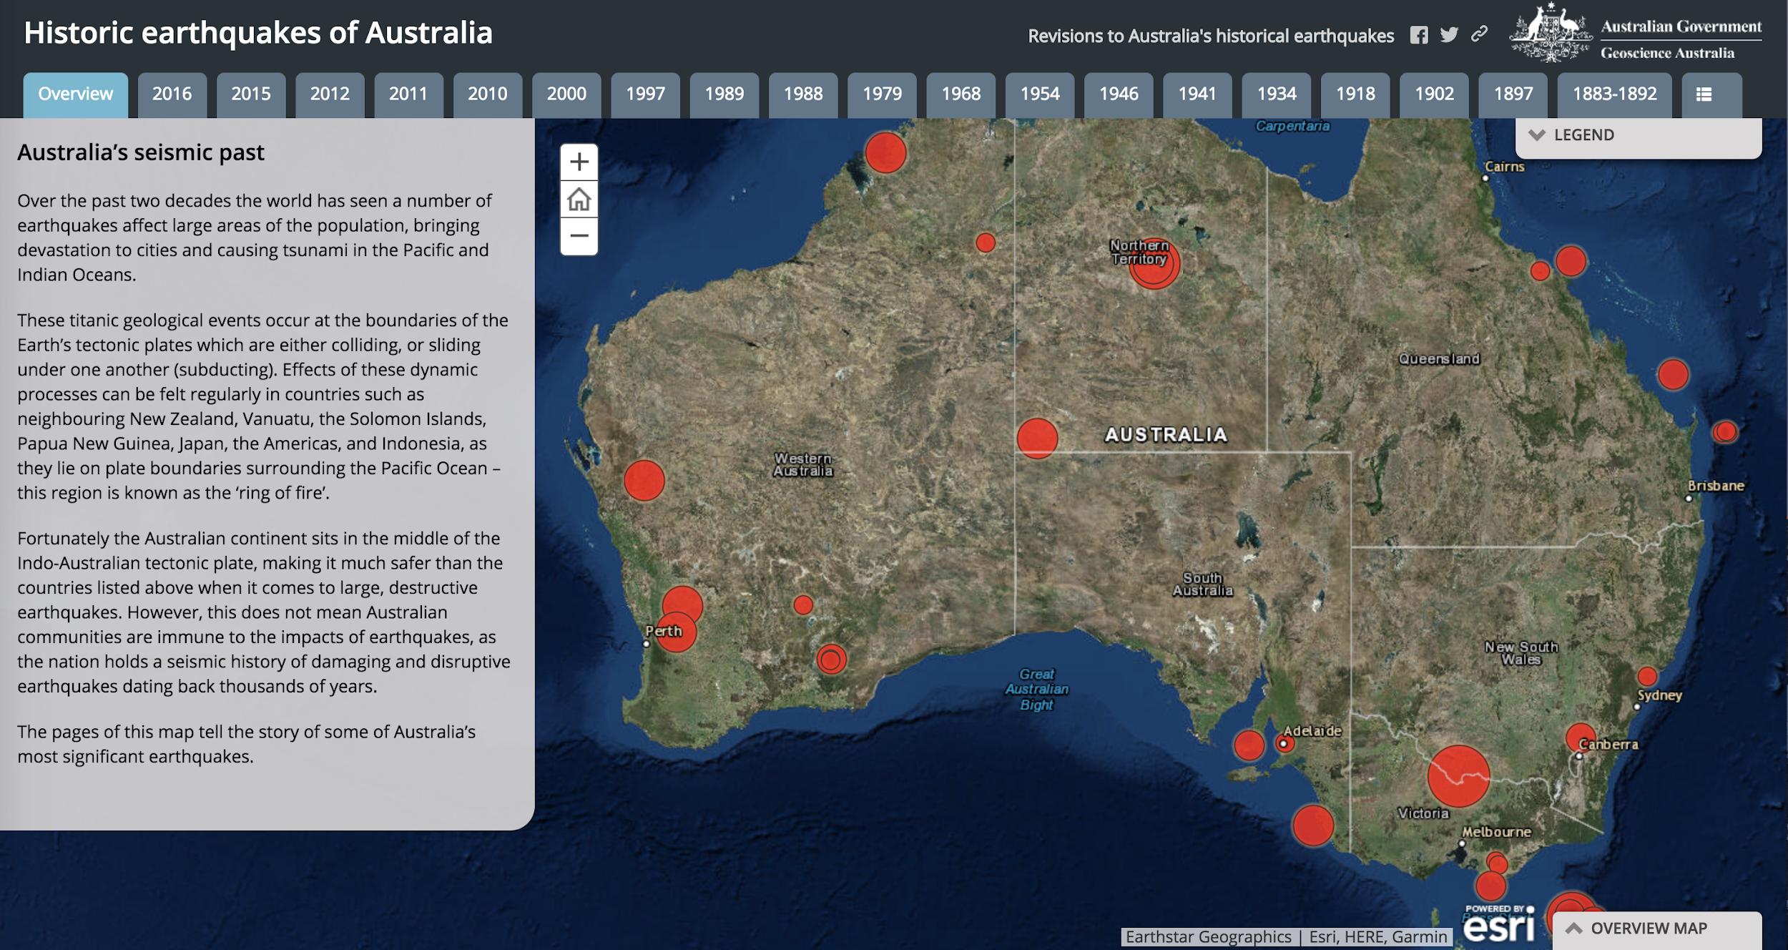
Example--Story Map Series
Story Map Series-Tabbed Layout: ideal for presenting a series of maps via tabs. You can add text and multimedia content to each map you add to the series.
Notes:
The Story Map Series is ideal for showing a series of different maps that includes long form text and multimedia. For example, this Historic earthquake map shows a number of earthquakes that happened in Australia. You can click through their locations by year and learn more about each of them in this series-based map.

Slide 10
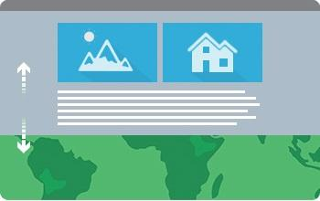
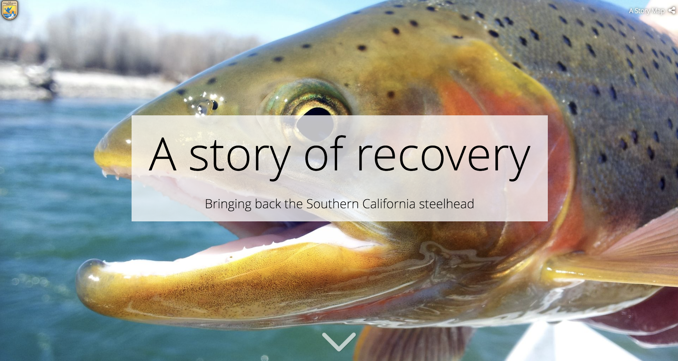
Example--Story Map Cascade
Story Map Cascade: ideal for presenting a full-screen scrolling experience that blends narrative text, maps, images, and videos. Sections contain text and in-line media with interactive transition effects.
Notes:
The Story Map Cascade provides a more engaging & interactive experience. You can scroll through media whether that is images, video, graphs, or maps with in-line transition effects. For example, this map tells a story about restoring the habitat of the steelhead fish of the Pacific Northwest. The cascade map provides lots of nice photos in addition to a map that outlines the range extension of the Southern California Steelhead. It is almost like wordpress except it provides a full-screen cascade model for telling the story.

Slide 11

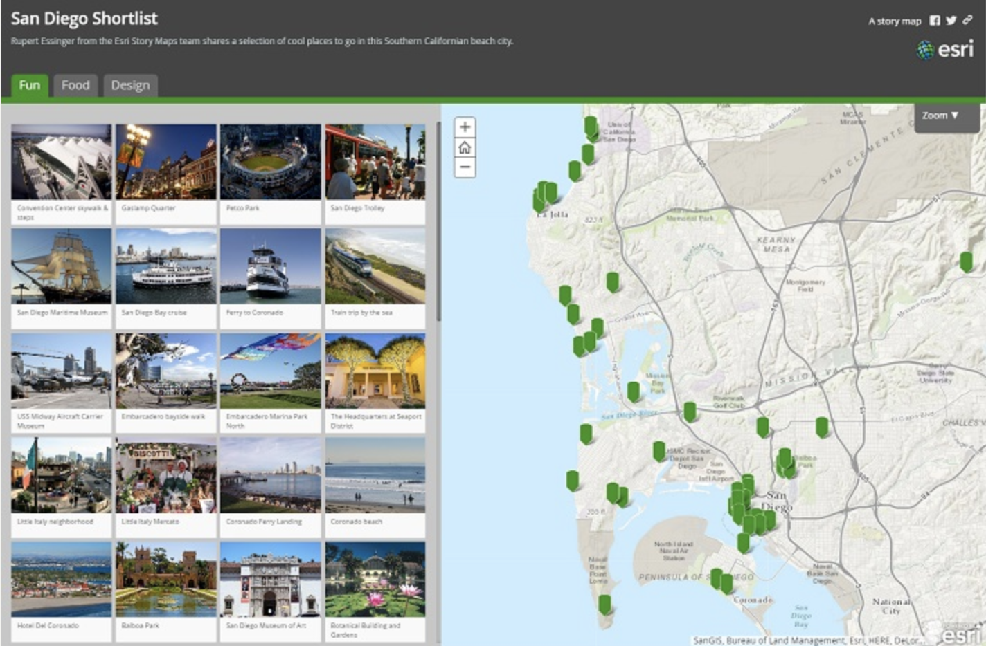
Example--Story Map Shortlist
Story Map Shortlist: ideal for presenting a large number of places organized into tabs based on themes (e.g. restaurants, hotels, and attractions).

Slide 12

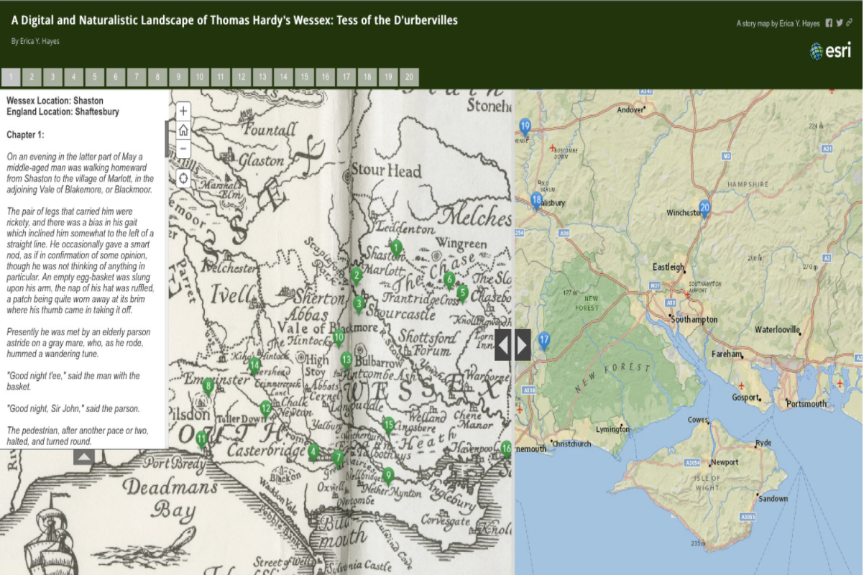
Example--Story Map Swipe
Story Map Swiper: ideal for comparing two separate web maps or two layers of a single map by sliding a swipe tool back and forth.

Slide 13

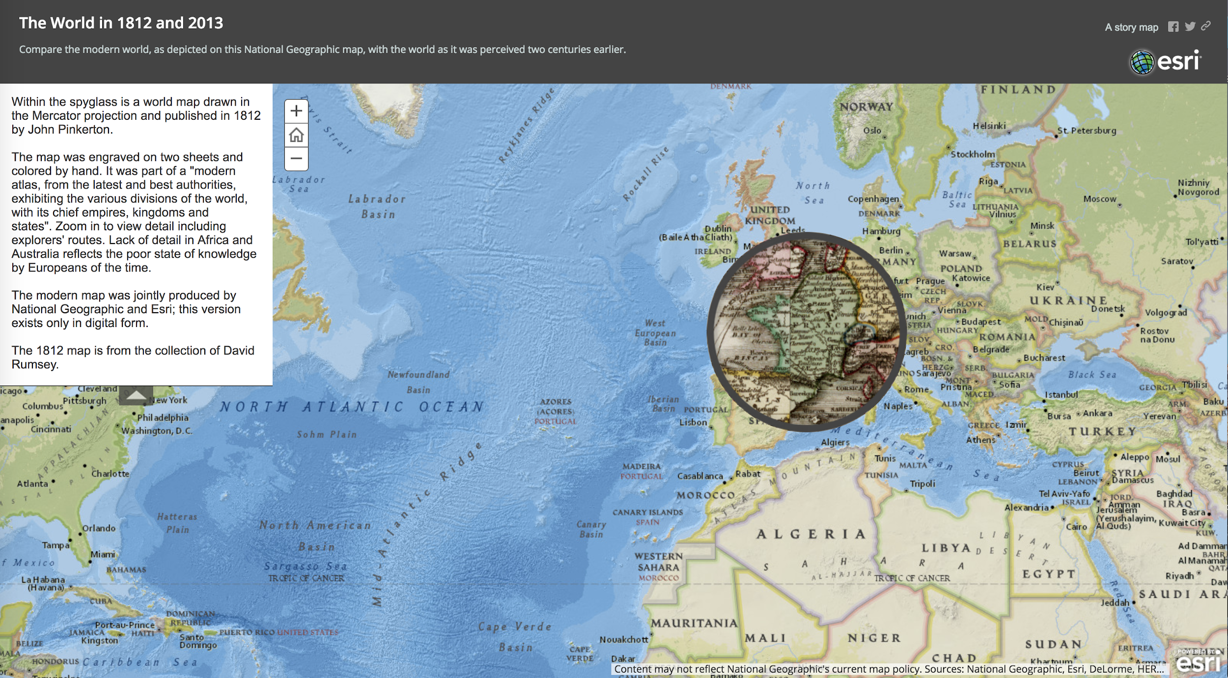
Example--Story Map Spyglass
Story Map Spyglass: similar to Story Map Swipe but the spyglass feature enables users to peer through one map on to another with a spyglass tool. Ideal for comparing a historical georeferenced map with a current map.

Slide 14
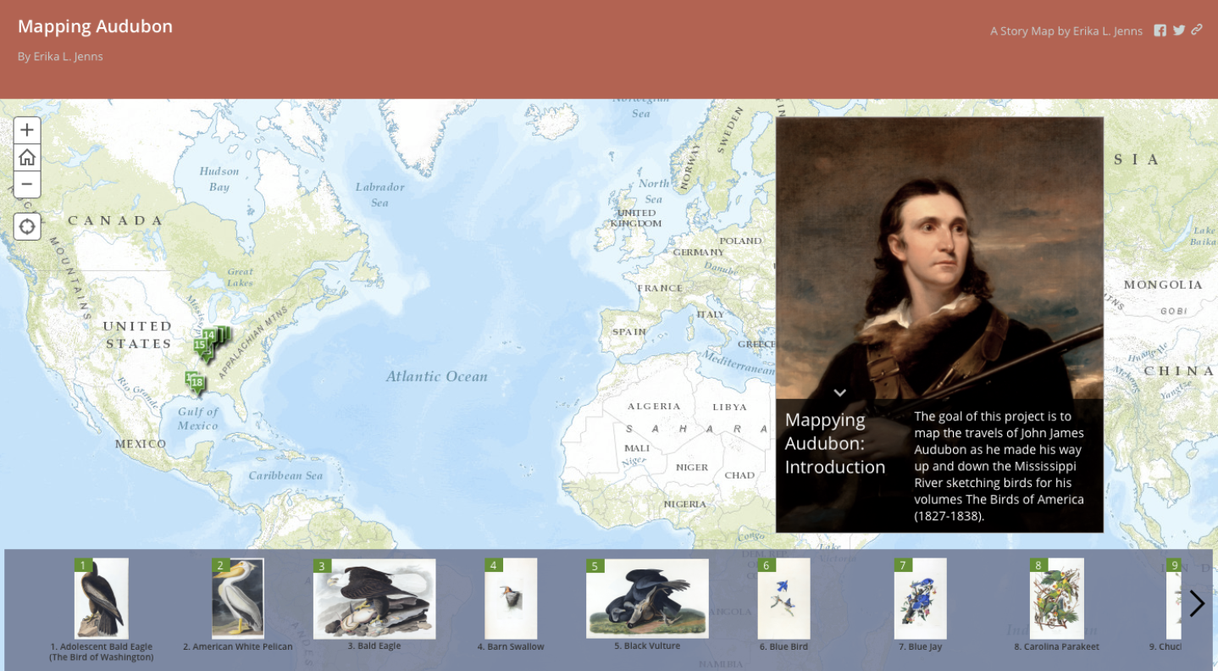
Example--Story Map Tour
Story Map Tour: ideal when you want to present a linear, place-based narrative featuring images. Each "story point" in the narrative is geo-located.

Slide 15
Esri E-Learning & Training
Provided by the NCSU Libraries
https://www.lib.ncsu.edu/gis/virtcamp

Slide 16
Today’s Activities:
Creating a Map Tour
Amelia Earhart’s 1937 Flight
&
a Map Journal of
Captain James Cook’s First Voyage

Slide 17
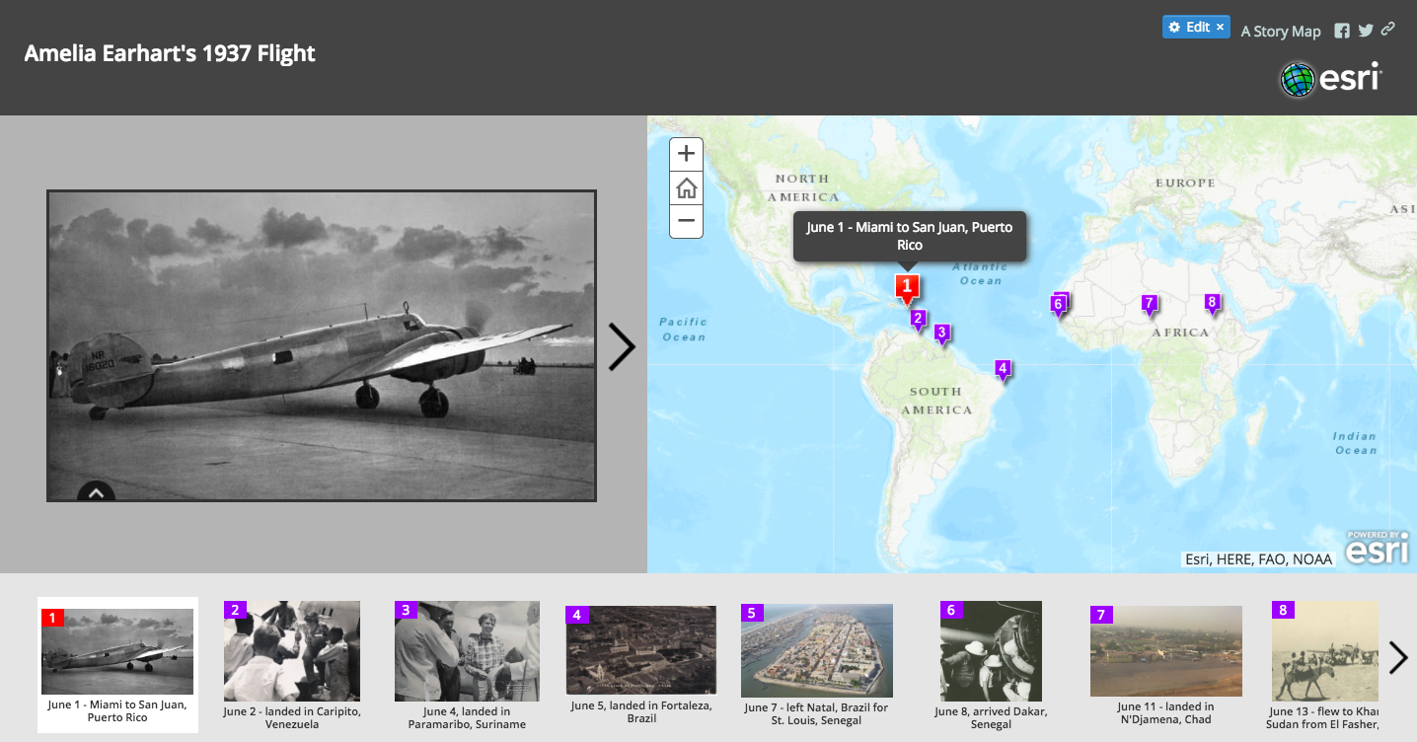

Slide 18
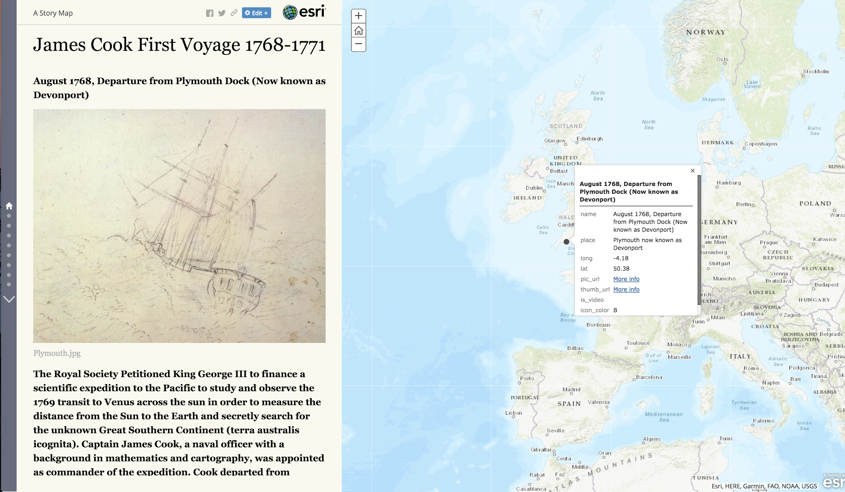

Slide 19
Getting started:
Create an ArcGIS Online account
https://www.arcgis.com/home/signin.html

Slide 20
Download workshop files:
http://go.ncsu.edu/storytelling-gis

Slide 21
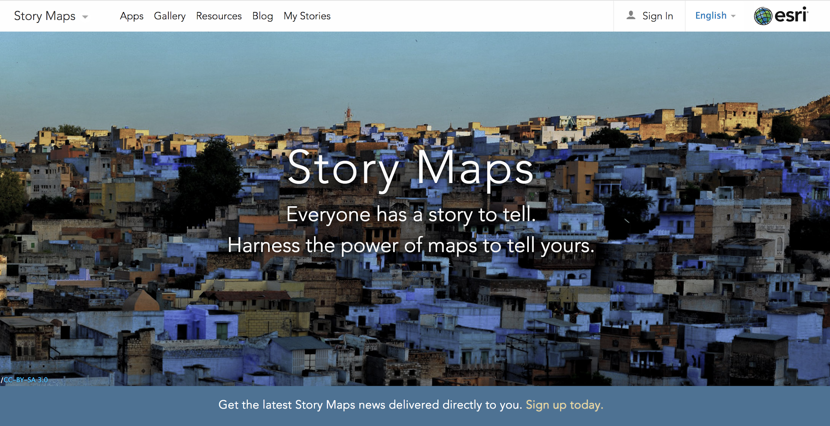
https://storymaps.arcgis.com/en/

Slide 22
Technical Advice
Image size should be less than 400 KB
JPG is the recommended file format
You can upload your images manually or link to them if they are hosted online in your csv
You can embed your map tour in another website using an iframe (see FAQ link on how to do it under helpful resources slide)
There is a 1,000 dataset point limit unless you want to download Story Maps and host it on your own website. For the Map Tour, you can add no more than 99 points. Keep in mind the larger your dataset, the slower your map will load.

Slide 23
Helpful Resources
Data and GIS Services at NCSU Libraries
Esri E-Learning Training at NCSU Libraries
Getting started with Esri Story Maps
Esri Story Maps FAQ
Esri Map Tour tutorial online
Esri Story Maps gallery
ArcGIS Online Assistant

Slide 24
Practice & Experiment!
Notes:
Add some prompts for things they can do, e.g. find their own photo

Slide 25


Contact info for more help or consultations!
Erica Hayes, NCSU Libraries Fellow
Copyright & Digital Scholarship Center (Digital Scholarship Specialist & Story Maps Enthusiast)
eyhayes@ncsu.edu
Mia Partlow, NCSU Libraries Fellow
Data & Visualization Department
mpduffy@ncsu.edu

Slide 26
Questions?

